Slide 1
COMP 3500 Introduction to Operating Systems Synchronization: Part 4 (cont.) Classical Synchronization Problems
Dr. Xiao Qin
Auburn University http://www.eng.auburn.edu/~xqin
xqin@auburn.edu
Notes:
50 Minutes: Slides ?

Slide 2
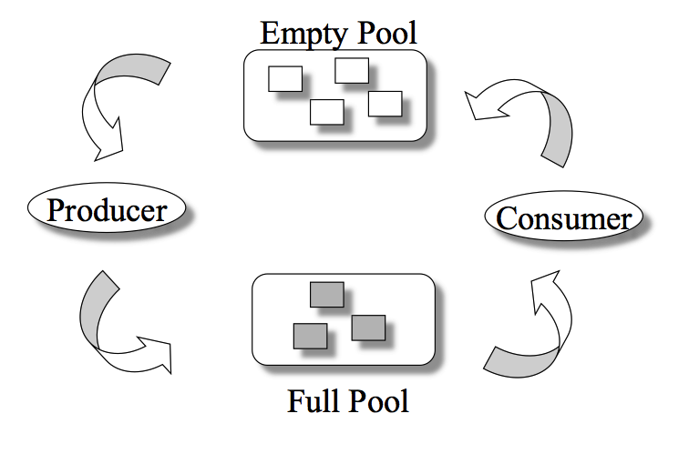
Recap: The Bounded-Buffer Problem
n buffers, each can hold one item
Semaphore mutex: initial value 1
Semaphore full: initial value 0
Semaphore empty initial value n
Notes:
Classical Problems of Synchronization
Classical problems used to test newly-proposed synchronization schemes
Bounded-Buffer Problem
Readers and Writers Problem
Dining-Philosophers Problem
Semaphore mutex initialized to the value 1
Semaphore full initialized to the value 0
Semaphore empty initialized to the value n

Slide 3
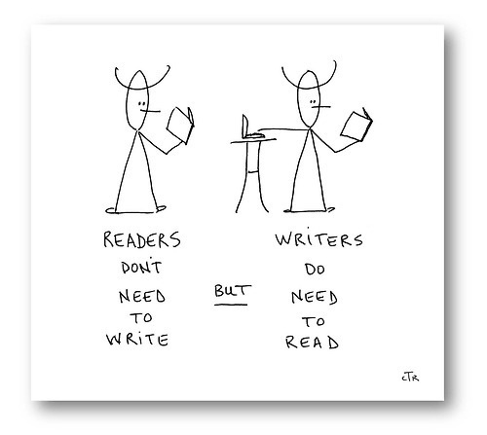
The Readers-Writers Problem
Concurrent processes
Readers – only read data; do not perform updates
Writers – both read and write
Problem:
Allow multiple readers to read at the same time
Only one single writer can access the shared data
Q1: What semaphores do we need?
Semaphore rw_mutex initialized to 1
Semaphore r_mutex initialized to 1
Integer reader_count initialized to 0
Notes:
A data set is shared among a number of concurrent processes
Readers – only read the data set; they do not perform any updates
Writers – can both read and write
Problem – allow multiple readers to read at the same time
Only one single writer can access the shared data at the same time
Several variations of how readers and writers are considered – all involve some form of priorities
Shared Data
Data set
Semaphore rw_mutex initialized to 1
Semaphore mutex initialized to 1
Integer read_count initialized to 0

Slide 4
The Writer Process Q2: Which semaphore should we use here?
Q3: Is it a semaphore or lock?
do { wait(rw_mutex);
... /* writing is performed */
...
signal(rw_mutex);
} while (true);
Only one single writer can access the shared data

Slide 5
The Reader Process Q6: Can you explain the following process?
do { wait(r_mutex); read_count++; if (reader_count == 1)
wait(rw_mutex);
signal(r_mutex);
... /* reading is performed */
...
wait(r_mutex); reader_count--; if (reader_count == 0)
signal(rw_mutex);
signal(r_mutex);
} while (true);
A writer is in the critical section, n readers are waiting. Then …
n-1 wait here
1st waits here
Critical section?
The last reader
Let a writer access
(2) Readers don’t compete against each other for the room
(1) Readers compete against writers for the reading room
Why readers have r_mutex, writers have NO w_mutex?

Slide 6
Other Readers-Writers Problems
Problem 1: no reader kept waiting unless writer has permission to use shared object
Problem 2: once writer is ready, it performs the write ASAP
Both may have starvation
Notes:
Problem is solved on some systems by kernel providing reader-writer locks

Slide 7
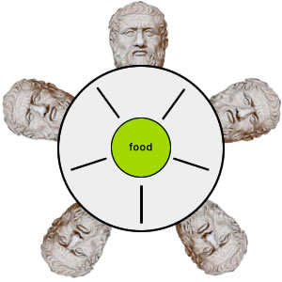
The Dining-Philosophers Problem
Philosophers spend their lives thinking and eating
Occasionally try to pick up 2 chopsticks (one at a time) to eat from bowl
In the case of 5 philosophers: Shared data
Bowl of rice
Semaphore chopstick [5] initialized to 1
Notes:
Philosophers spend their lives alternating thinking and eating
Don’t interact with their neighbors, occasionally try to pick up 2 chopsticks (one at a time) to eat from bowl
Need both to eat, then release both when done
In the case of 5 philosophers
Shared data
Bowl of rice (data set)
Semaphore chopstick [5] initialized to 1

Slide 8
The structure of Philosopher i
do {
wait (chopstick[i] );
wait (chopStick[ (i + 1) % 5] );
// eat
signal (chopstick[i] );
signal (chopstick[ (i + 1) % 5] );
// think
} while (TRUE);
Q7: What is the problem with this algorithm?

Slide 9
Deadlock Handling
Allow at most 4 philosophers to be sitting simultaneously at the table.
Allow a philosopher to pick up the forks only if both are available (picking must be done in a critical section.
Use an asymmetric solution -- an odd-numbered philosopher picks up first the left chopstick and then the right chopstick. Even-numbered philosopher picks up first the right chopstick and then the left chopstick.
Notes:
Allow at most 4 philosophers to be sitting simultaneously at the table.
Allow a philosopher to pick up the forks only if both are available (picking must be done in a critical section.
Use an asymmetric solution -- an odd-numbered philosopher picks up first the left chopstick and then the right chopstick. Even-numbered philosopher picks up first the right chopstick and then the left chopstick.

Slide 10
Problems with Semaphores
Incorrect use of semaphore operations:
signal (mutex) …. wait (mutex)
wait (mutex) … wait (mutex)
Omitting of wait (mutex) or signal (mutex) (or both)
Deadlock and starvation are possible.

Slide 11
Monitors
A high-level abstraction for process synchronization
Abstract data type: internal variables only accessible by code within the procedure
Only one process may be active within the monitor at a time
But not powerful enough to model some synchronization schemes
monitor monitor-name
{
// shared variable declarations
procedure P1 (…) { …. }
procedure Pn (…) {……}
Initialization code (…) { … }
}
Notes:
A high-level abstraction that provides a convenient and effective mechanism for process synchronization
Abstract data type, internal variables only accessible by code within the procedure
Only one process may be active within the monitor at a time
But not powerful enough to model some synchronization schemes

Slide 12
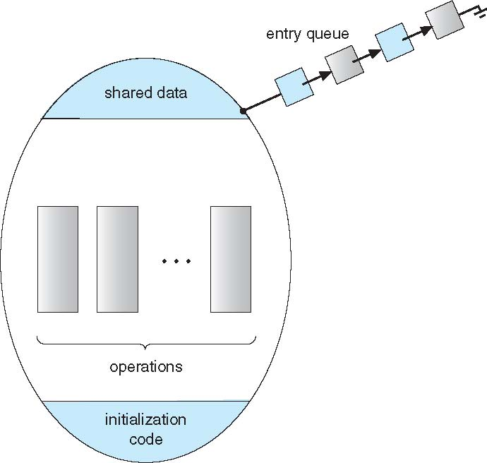
A Monitor

Slide 13
Summary
The Readers-Writers Problem
The Dining-Philosophers Problem
Introduction to Monitors

